Slide 1

How to Prepare General Ledger Account Reconciliations
Carter Kaufmann

Slide 2
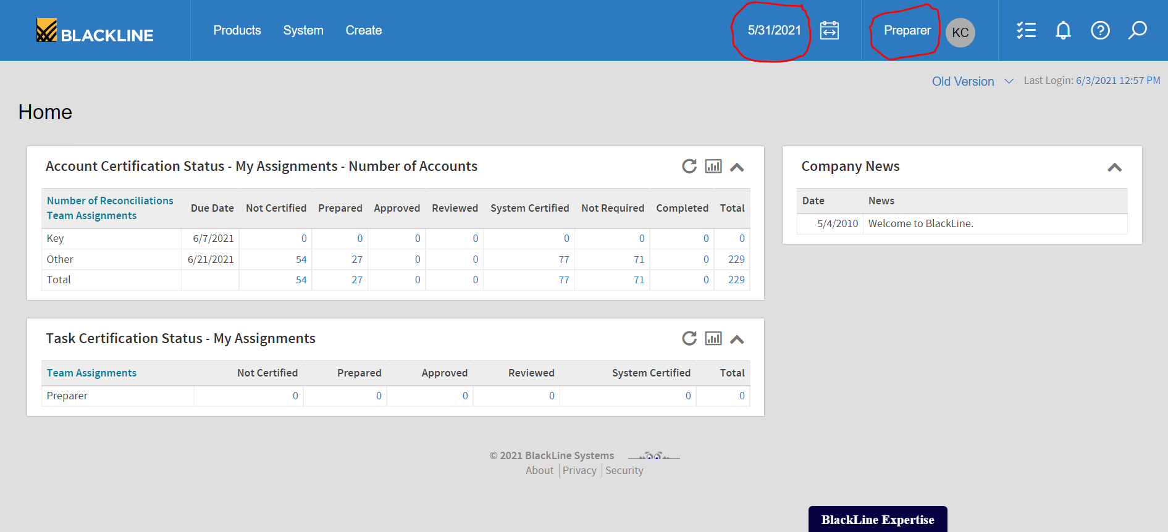
Log in to Blackline
Make sure you are under the “Preparer” role
Verify you’re in the proper period, in order to prepare month end reconciliations

Slide 3
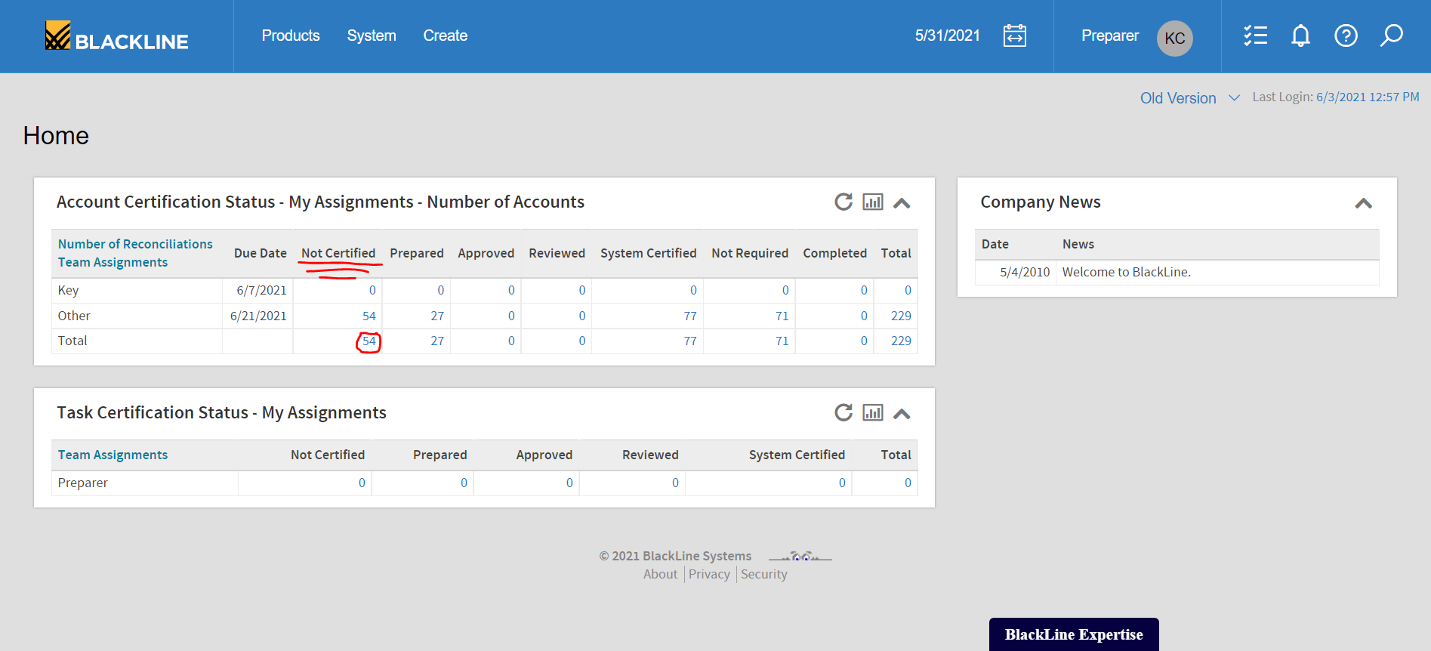
Click the number of “Not Certified” total reconciliations (in this case 54)
(The number of “Prepared” reconciliations will increase as you complete them)
The reconciliations will be categorized as ”Completed” once they are reviewed and approved by the approver closer to month end

Slide 4
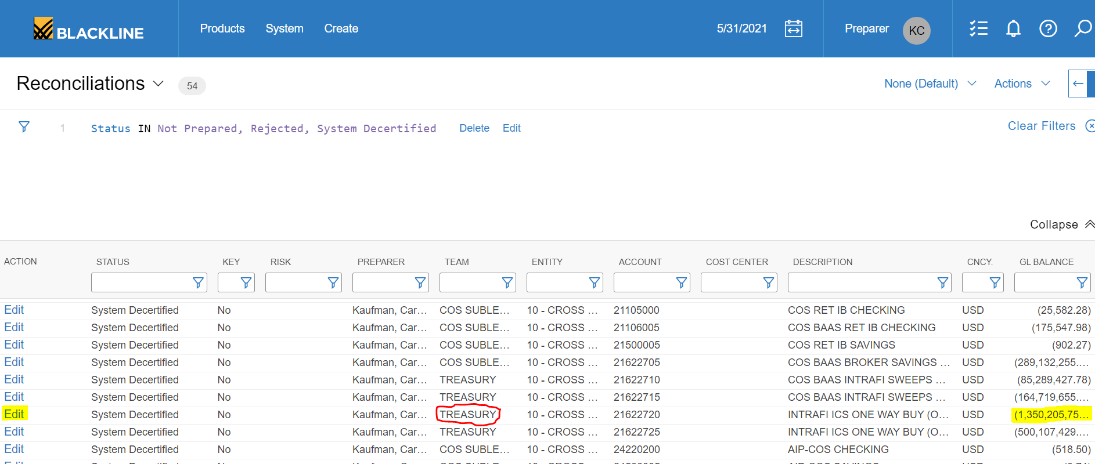
Next, click the “Edit” button on the left-hand side (highlighted in yellow) to go into the Treasury IntraFi OWB rec and prepare the reconciliation.

Slide 5
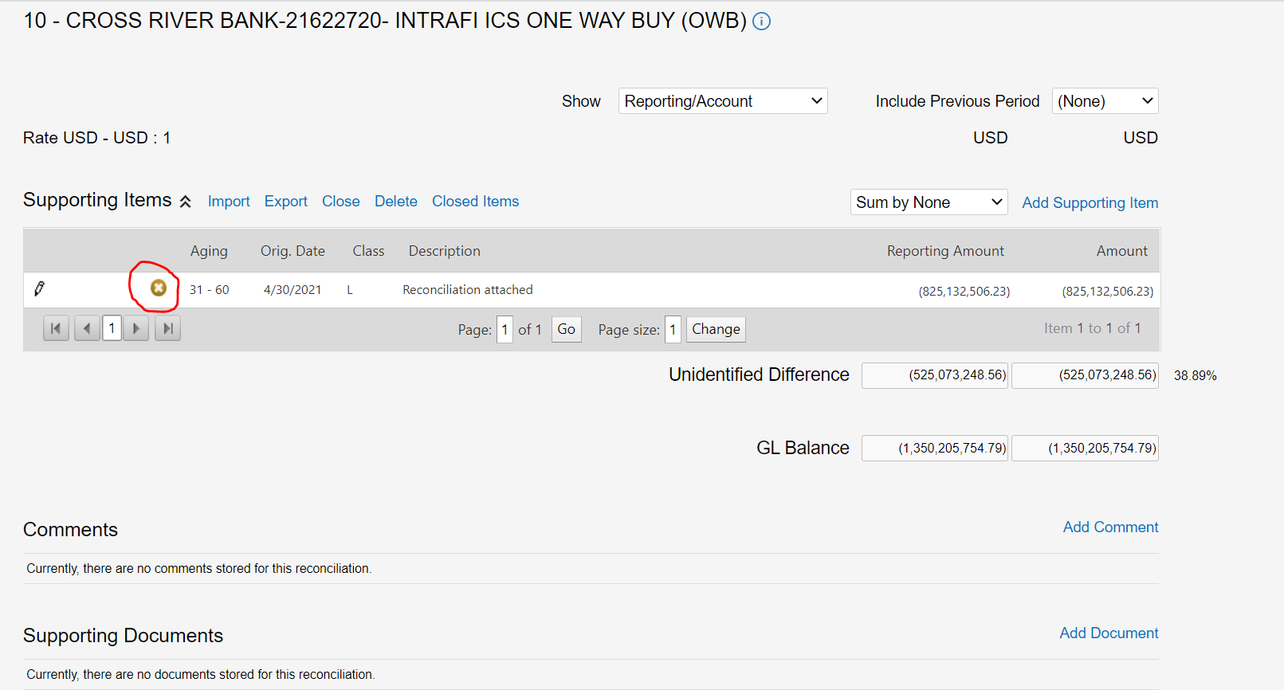
Click the “X” (circled in red below) so that Figures from prior periods don’t pile up in any accounts. Then click “Add Supporting Item”

Slide 6
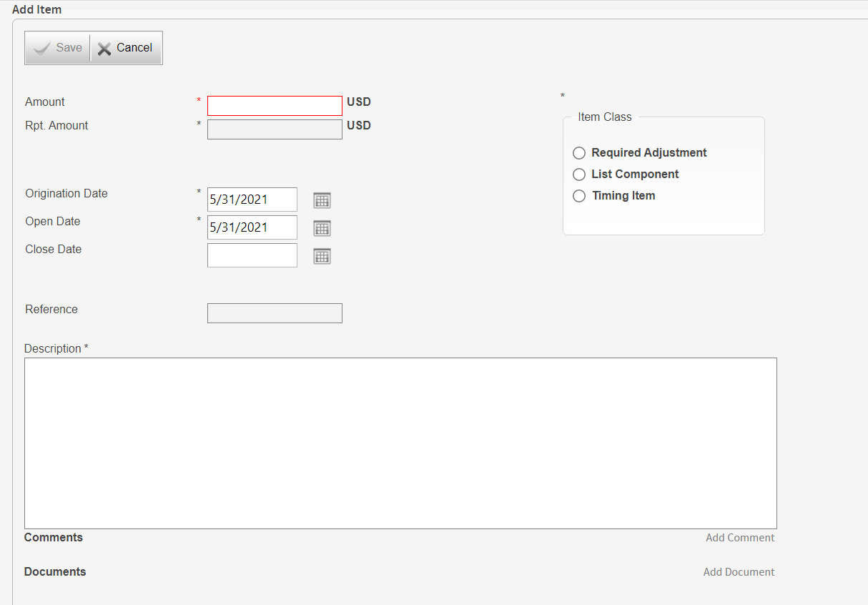
Select the item class.
(You can see the definitions of all three item classes if you hover over the respective bullet point for each class)
Enter the amount for the line item
Lastly, enter a short description such as “Reconciliation is attached”.
(Once the unidentified difference is zero, and the line items equate to the GL balance shown, it is okay to proceed)

Slide 7
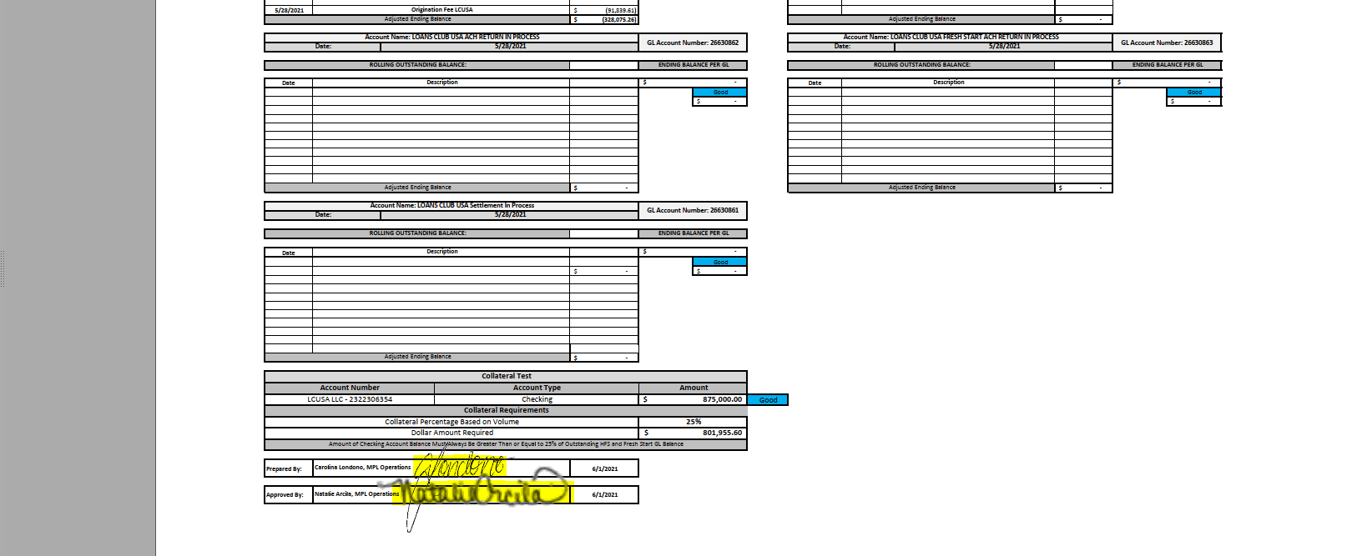
Make sure that the signatures of the preparer and approver of the reconciliation are included on the bottom of the document (as shown here)

Slide 8
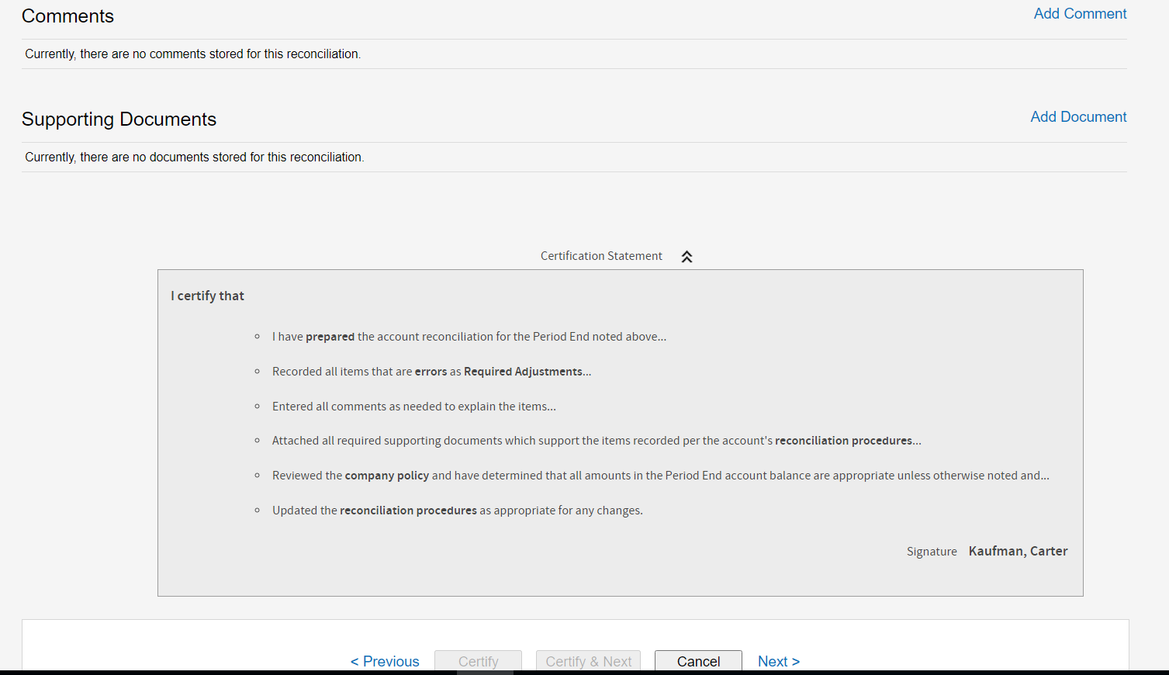
Always add supporting document(s) to show that the GL balances match
Adding ‘Comments’ onto the reconciliation are optional but always helpful
Once you are confident that you have prepared the reconciliation appropriately, click “Certify” on the bottom

Slide 9
Congratulations on Successfully Preparing a Reconciliation!

